Slide 1

Learning Intention:
Today we are considering if religion and science are compatible.
Success criteria:
By the end of the lesson I will be able to:
Understand the arguments that both agree and disagree with this idea.
Have thought more deeply about my own opinion.

Slide 2
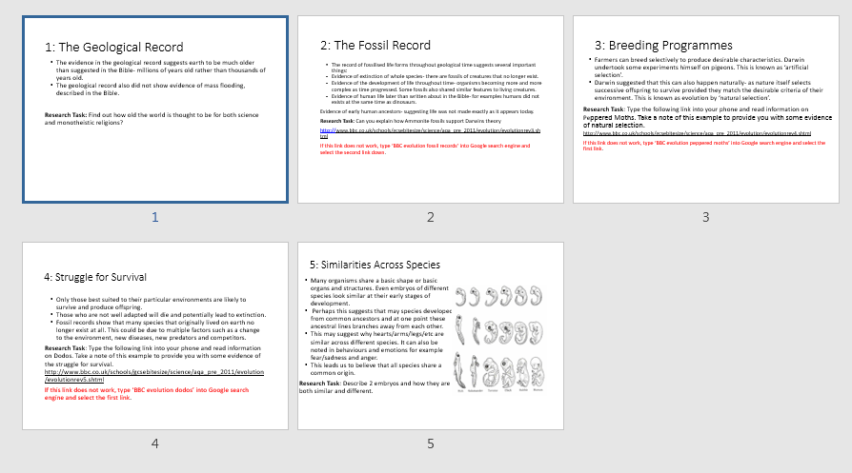
Homework.
https://www.classtools.net/random-name-picker/89_VjeeWh

Slide 3
The mandatory content
Existence of God mandatory content.
Does God exist?
. What arguments/theories do religious people use to prove the existence of God?
. What evidence do religious people use to support these arguments/theories?
. What are the strengths and weaknesses of evidence/arguments/theories?
. What arguments/theories do non-religious people use to challenge the existence of God?
. What evidence do non-religious people use to support these arguments/theories?
. What are the strengths and weaknesses of evidence/arguments/theories?
. Can either religious or non-religious arguments/theories provide conclusive proof about the existence of God?

Slide 4
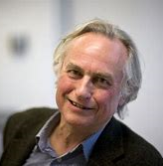
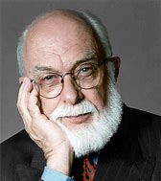
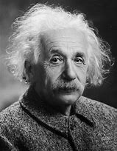
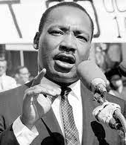
What are the following quotations saying about science and religion? Which one to you agree with the most?
‘Faith is the great cop-out, the great excuse to evade the need to think and evaluate evidence. Faith is belief in spite of, even perhaps because of, the lack of evidence.’
Richard Dawkins
“Expose every belief to the light of reason, discourse, facts, scientific observations; question everything, be sceptical because this is the only chance at life you will ever get.”
James Randi
'Science without
religion is lame,
religion without
science is blind.‘
Albert Einstein
Science investigates; religion interprets. Science gives man knowledge, which is power; religion gives man wisdom, which is control. Science deals mainly with facts; religion deals mainly with values. The two are not rivals.” Martin Luther King

Slide 5
Are science and religion compatible ?
Yes
No, science is right
No religion is right

Slide 6
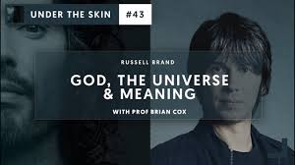
“Science disproves God.”
Discuss !
https://www.youtube.com/watch?v=6gWX2chGpOw

Slide 7
Yes they are compatible
Are science and religion compatible ?
1. Science does not put an end to a creator God.
God can be seen as the cause of the Big Bang. He used this as his method for creation.
2. Both faith and reason agree that there is a first cause and that infinite regress is not possible.
3. Science answers questions about the physical world whereas religion answers questions about the spiritual world and so you can accept both.
Religion and God answer questions about the meaning and purpose of life which science can’t.

Slide 8
No, they are not compatible.
Religion is right.
1. Some theists would argue that the Big Bang and evolution theory's are not fact and can be doubted. The evidence might be wrong.
They can argue that science has been wrong in the past and may be wrong again (e.g the world is flat).
2. Both scientific theories cannot give meaning to life, therefore are irrelevant.
3. In the Bible there is no mention of the Big Bang or evolution and natural selection and so cannot be true.

Slide 9
No, they are not compatible. Science is right.
1. Those who accept only science would argue that the creation story and arguments for the existence of God should be rejected as they are largely based on faith and not observation.
2. The Big bang and Darwins theory are largely based on empirical evidence and can therefore be tested.
3. Science removes the need for God.

Slide 10
Very sure God exists
So as we finish this unit lets think about our own beliefs, see if our views have changed.
Imagine there is a line going down the classroom. Place yourself on the line depending on whether you believe in God or not.
The closer to the window that you are the more convinced you are that he exists.
Very sure God does not exist

Slide 11



